Slide 1
Capstone Project Hotel Booking Analysis
Team Members
Anamika
Ayush Goyal Durgesh Mishra

Slide 2
Content
We can divide the Analysis into 2 sections--
We deal with Data Collection, Data Exploration, Data Cleaning part.
We extract information from our data and try to answer some really important questions that govern the bookings.

Slide 3

Data collection--
Importing the required libraries
Load the file
Data Exploration--
Shape & Size
Descriptive statistics
Data Cleaning--
Duplicate Data & Missing Data
Feature selection
Converting datatype & Replacing values
Datetime operations
Dealing with Outliers

Slide 4
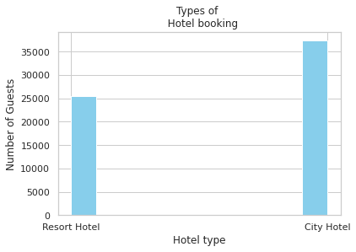
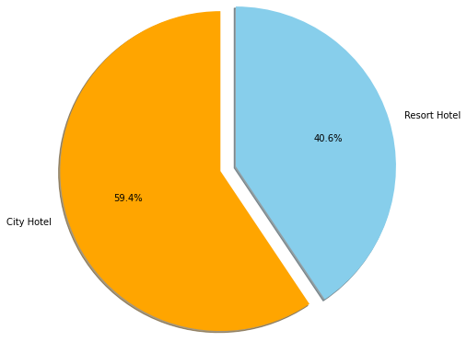
Types of hotel booking & Booking ratio?

Slide 5
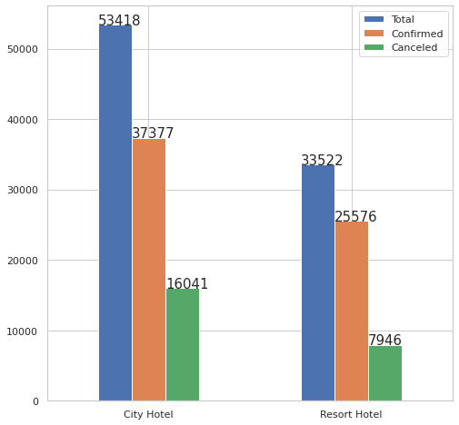
Distribution of Bookings

Slide 6
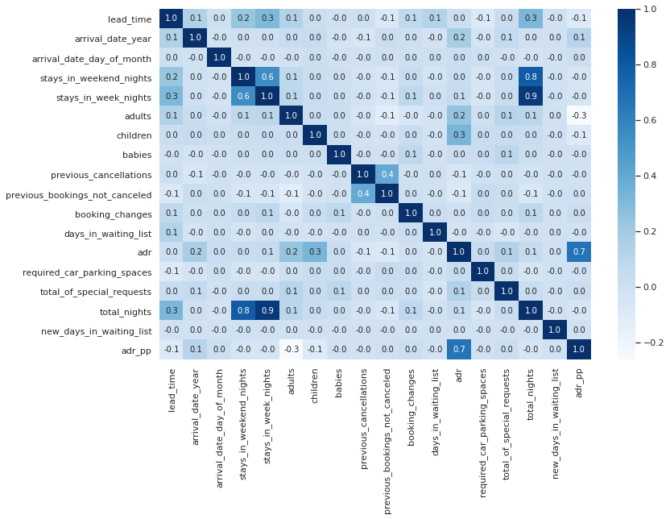
Bi-Variate Analysis

Slide 7
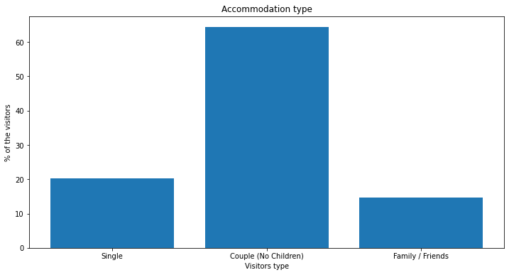
Which was the most booked accommodation type?

Slide 8
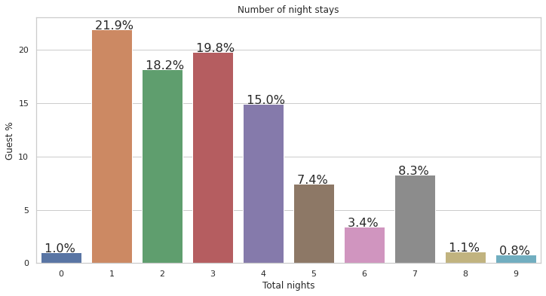
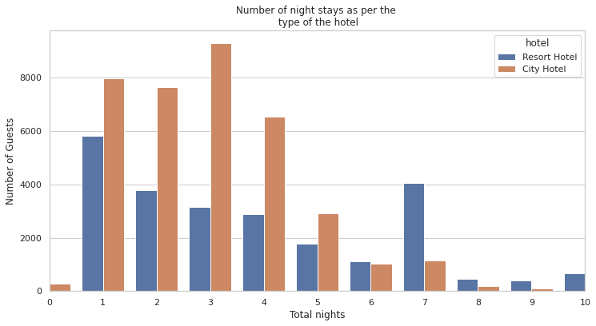
How many nights does visitors prefer to stay?

Slide 9
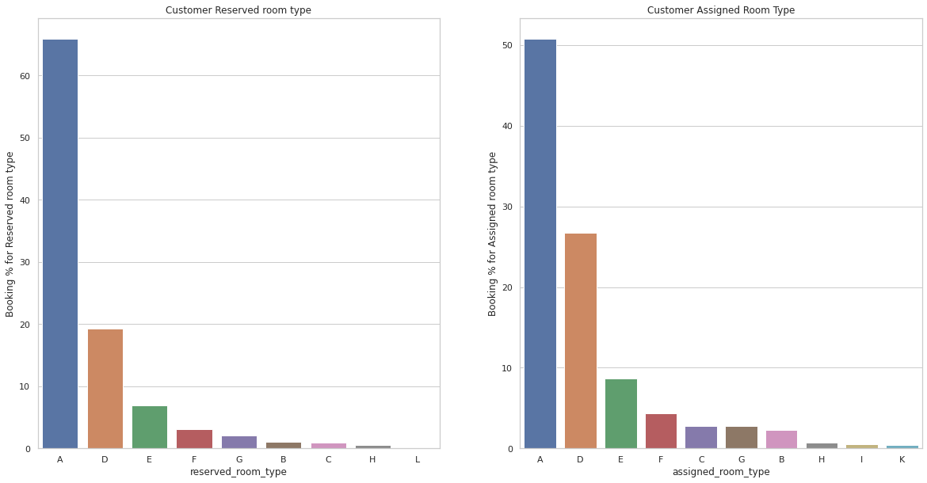
Reserved Room & Assigned Room type Bookings

Slide 10
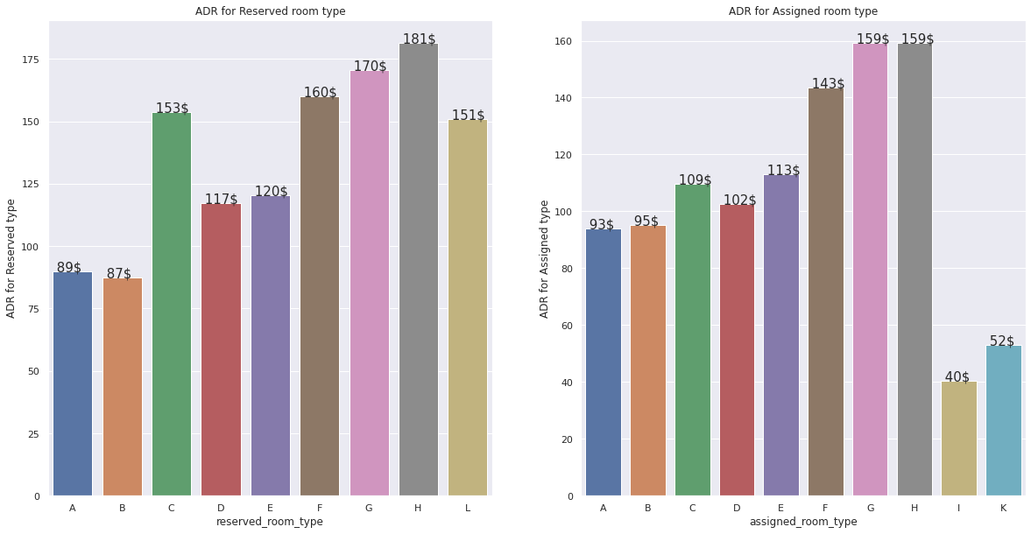
ADR for Reserved & Assigned Room type

Slide 11

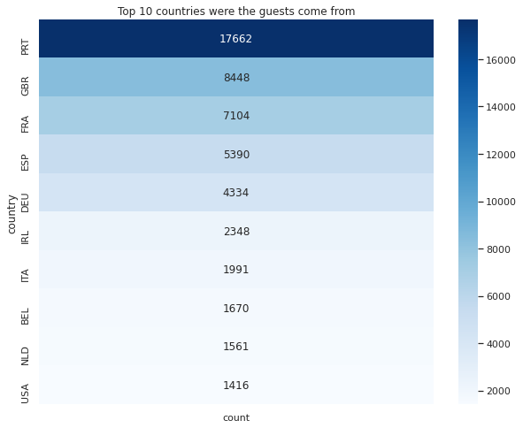
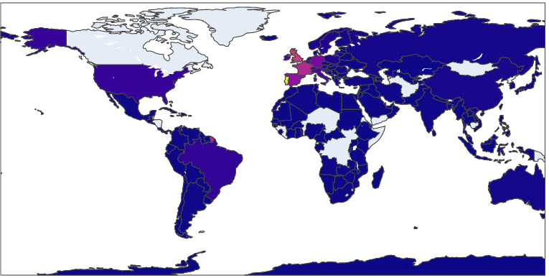
From which Country most Visitors come from?

Slide 12
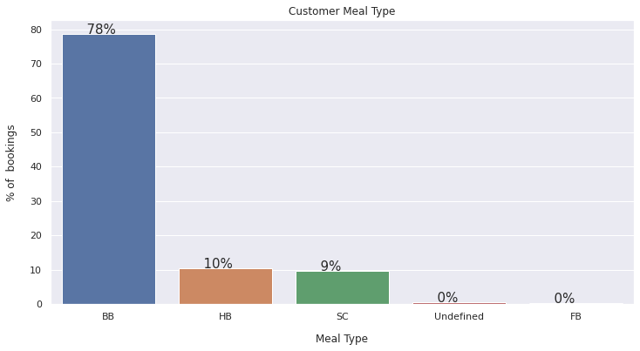
Types of meal booked by the customers?

Slide 13
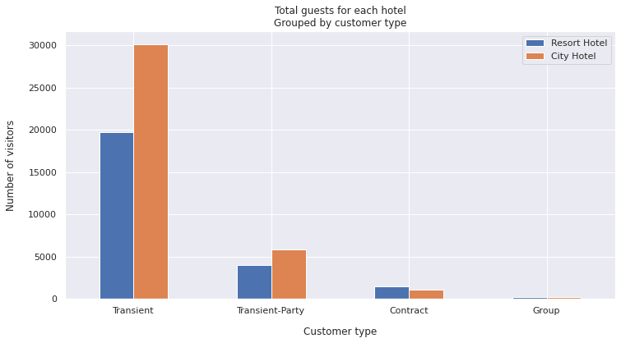
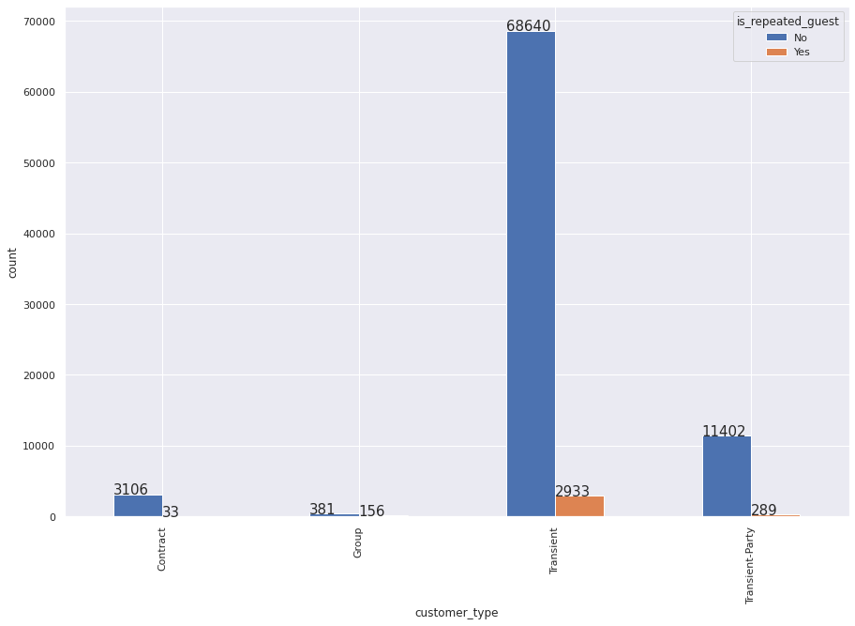
Customer Type & Repeated Guest

Slide 14
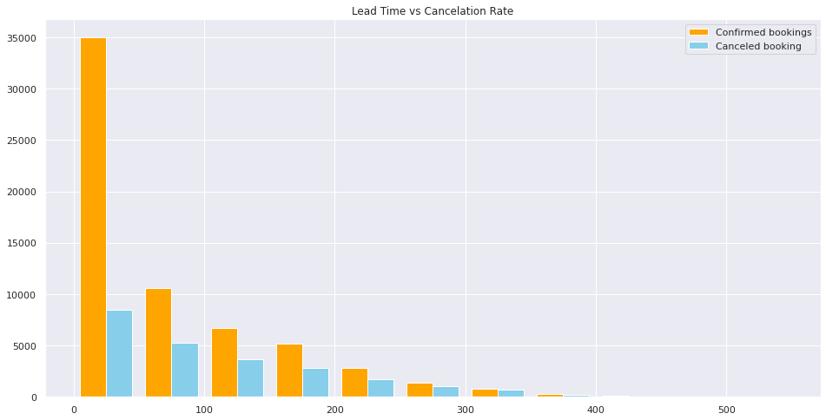
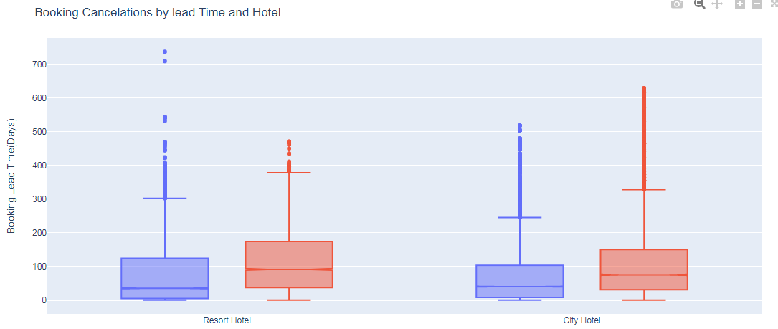

Lead Time & Cancelation Rate?

Slide 15
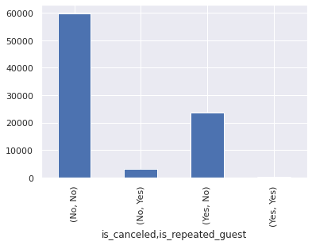
Repeated Customer & Cancelation

Slide 16
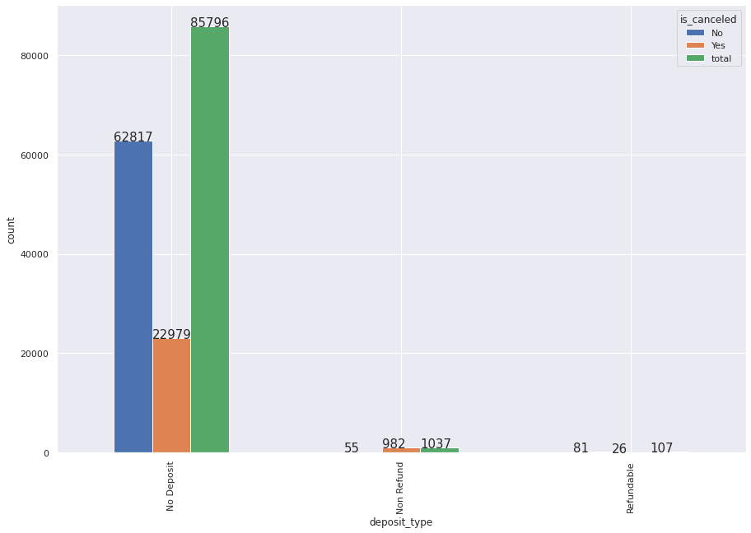
Deposit & Cancellation

Slide 17
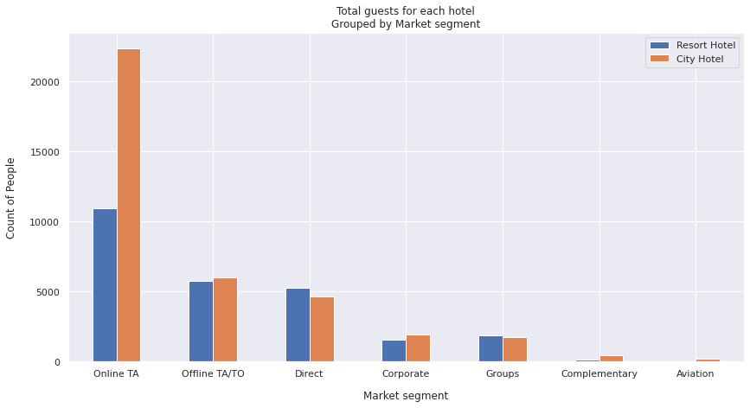
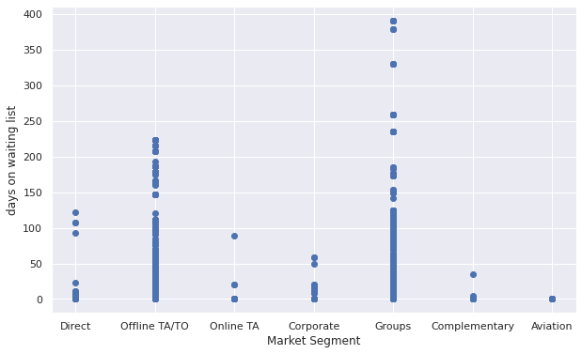
Market Segments & Waiting list days

Slide 18
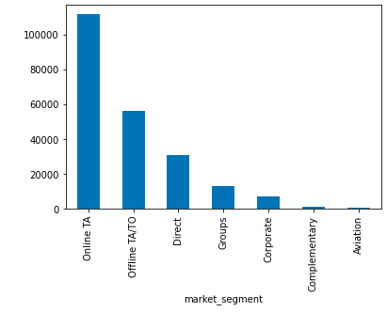
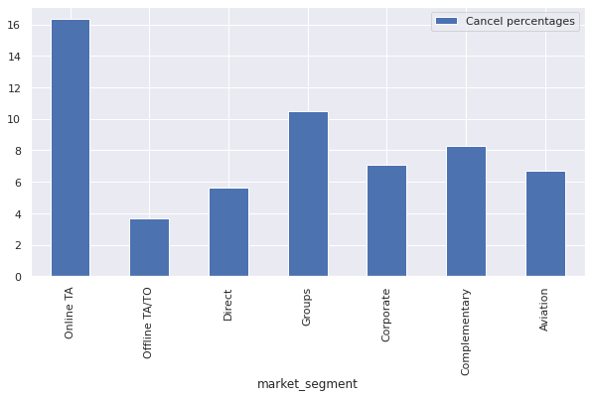
Accommodated Nights & Cancellation % for Market segment

Slide 19
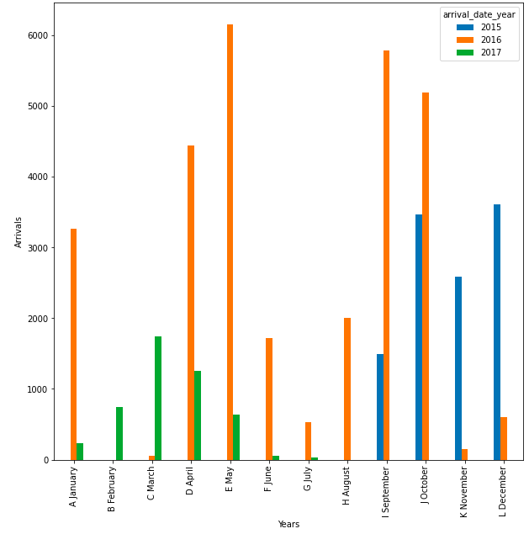
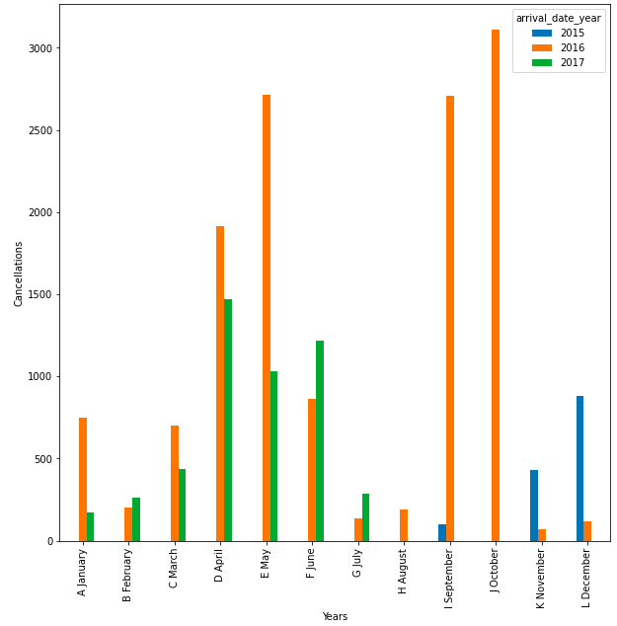
Waiting days of Cancelled & Confirmed bookings

Slide 20
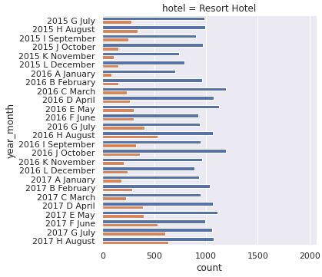
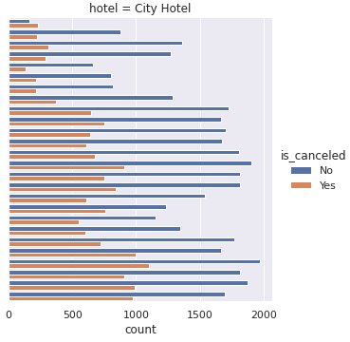
Cancellation & Arrival status

Slide 21
Conclusion:
Easy and hassle free bookings are mostly preferred like through online agents or offline agents therefore hotels can also introduce their own travel agent facility within their premises, to attract more bookings.
The cancellation rate of groups arriving is a great concern as we have second highest cancellation rate despite of a very low arrival rate, therefore we can introduce non refundable bookings for groups in exchange of discounted prices.
Direct bookings should be promoted as well through various perks and discounts.
In resort hotels we are having a higher cancellation rate in 2nd and third quarter which needs to be focused upon.
First and third quarter needs to have some attention due to having higher cancellation rate and, apart from this 4th quarter needs even more attention due to its constant cancellation and very few arrivals which is a major concern.

Slide 22
Around 60% of booking is done in City Hotels as compared to Resort Hotels. Resort hotels could reduce prices to increases booking percentages & also promote the hotels more.
Couple (or 2 adults) is the most popular accommodation type. So hotels can make arrangement plans accordingly.
For most cases there are no deposits for both City Hotels & Resort Hotels.
We can see that there is some seasonality during the years, which is normal in hospitality, which gets more bookings in the Spring. This could be because of weather conditions as people prefer going on vacation during more comfortable seasons such as Spring/Summer and not during Winters.

Slide 23
Challenges
Non uniform data due to lack of enough information of all months of different years.
Different variable names by each member due to lack of coordination
There are many irrelevant features, duplicate & missing data. Moreover, null values and duplicate values identification was a great challenge due to lack of proper unique Identification number.
The Dataset contains many outliers such as 55 adults in a single room, there is a booking with a lead time of 737 days, $5,400 for ADR, and so on.

Slide 24


